Slide 1
Renting Your Own Apartment
College Prep
Mr. Gordon
jgordon@bisdtx.org

Slide 2
Upcoming Events
hi

Slide 3
Renting Your Own Apartment
Common Terms:
Landlord- the person who owns the property.
Lease Agreement or Lease- a legal contract between the landlord and renter that covers the length of time, price, and services included ie electricity, water, garbage, internet. If the renter or landlord breaks the lease, they may be forced to pay a fine or even go to court.
Rent- monthly payment made to the landlord.
hi

Slide 4
Renting Your Own Apartment
Common Terms:
Deposit- amount you put down to reserve the apartment and in case any damage occurs. Can be first or last month’s rent usually returned at the end.
BR- Bedroom, BA- Bathroom
For example: 2BR, 1 BA means 2 bedrooms, 1 bath
W/D Washer/ Dryer
Sqft or ft2- square footage (size) of the apartment
Pet friendly- may require a pet deposit (see above)
Studio Apartment- all rooms, except bathroom, are open and in one room
hi

Slide 5
Renting Your Own Apartment
You can lease an apartment for one month, three months, six months, or a year, with the most common being a year.
The shorter the lease, the more expensive the monthly rent since the landlord may have to find another renter.
For example
1 year- $1,200
6 months- $1,400
3 months- $1,500
1 month- $1,800
hi

Slide 6
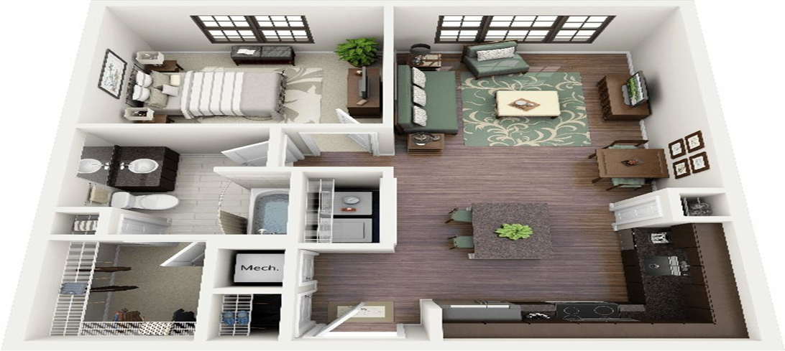
Renting Your Own Apartment
You can lease an apartment for one month, three months, six months, or a year, with the most common being a year.
The shorter the lease, the more expensive the monthly rent since the landlord may have to find another renter.
For example
1 year- $1,200
6 months- $1,400
3 months- $1,500
1 month- $1,800
hi

Slide 7
Renting Your Own Apartment
Why would a shorter lease be a good idea?
You are moving to Chicago for a new job. You have only been to Chicago a few times for the interview and a vacation. You get a 3 month lease, which gives you time to explore the city and perhaps find a better located or more affordable apartment.
hi

Slide 8
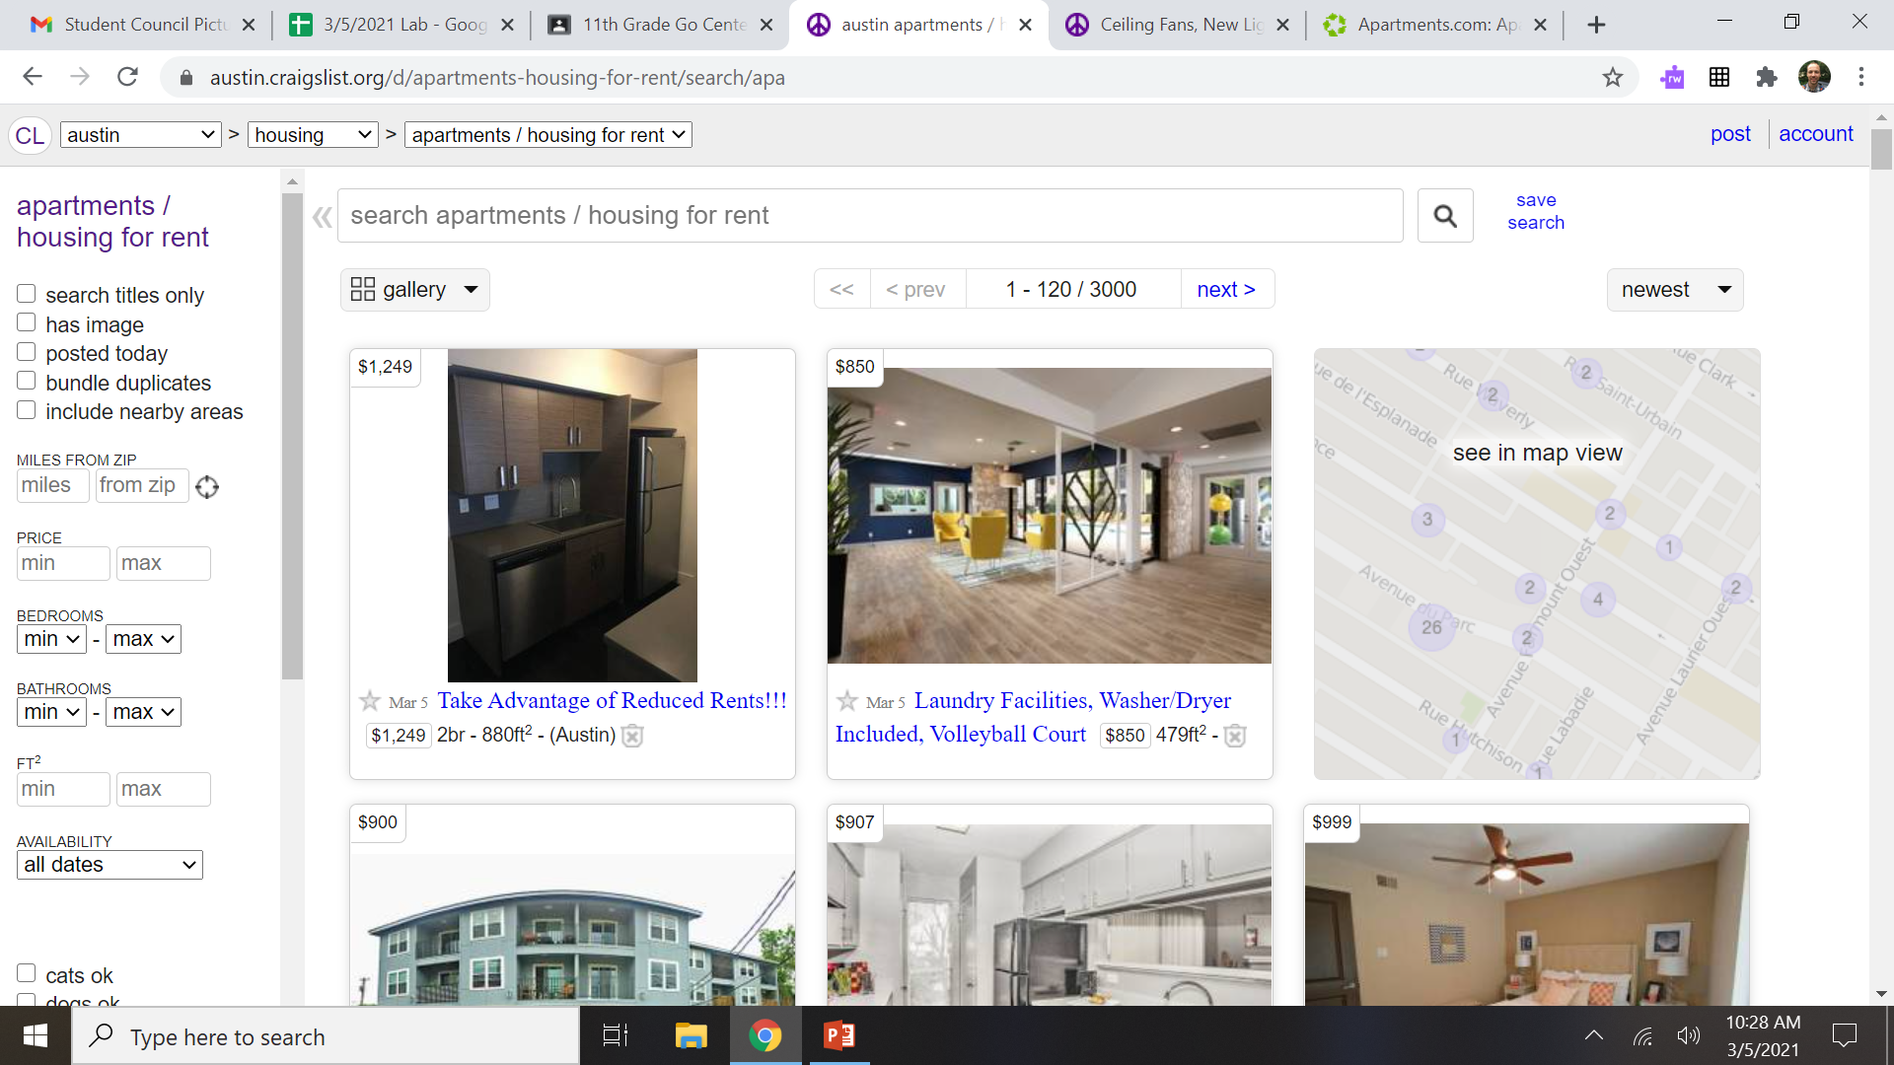
Renting Your Own Apartment
Available apartments can be found on Craigslist, apartments.com, in the paper, or just walking around.
Do your research and always tour the apartment before renting it.
hi

Slide 9
Renting Your Own Apartment
To Roommate or not to Roommate?
Pros:
The main cost of a rental goes into the kitchen and living room.
To have roommates is always the cheaper option than living alone.
For example 1 BR, 1 BA could be $1,200, whereas a 2 BR, 1 BA is $1,400 saving you $500. The more roommates the better 4 BR, 2 BA $2,000 equals $500 a person.
Cons:
You are sharing your space with another person. You may not get along with the person.
hi

Slide 10
Renting Your Own Apartment
Links for more information
https://www.apartments.com/blog
https://www.allstate.com/tr/renters-insurance/different-types-of-apartments.aspx
In the comments sections, please answer the following question:
Why would it be a good idea to get a one month lease?
hi

